Slide 1
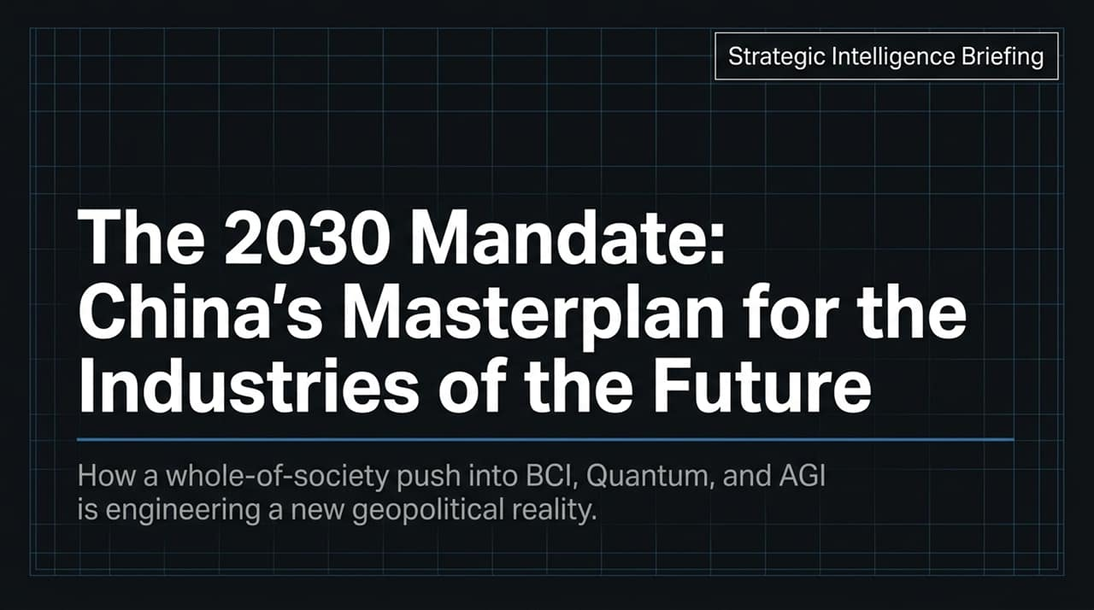
Notes:
Introduction & Context: Good morning/afternoon everyone. Today, we are analyzing China's masterplan for frontier science and technology, titled "The 2030 Mandate: China's Masterplan for the Industries of the Future".
Core Thesis: Beijing is mobilizing a "whole-of-society" strategy to dominate six critical future industries—specifically Brain-Computer Interfaces (BCI), Quantum Computing, Artificial General Intelligence (AGI), Biomanufacturing, Nuclear Fusion, and Embodied AI.
Geopolitical Imperative: This is not merely an R&D initiative; it is a coordinated campaign to re-engineer global supply chains, create strategic dominance, and achieve a geopolitical reality where Chinese technological infrastructure forms the bedrock of the global economy.
Key Takeaway: Over the next 45 minutes, we will unpack how China plans to commercialize these technologies by 2030 as a stepping stone toward its 2049 centenary vision.
Inside China’s Plan To Build The Industries Of The Future | When Titans Clash
https://www.youtube.com/watch?v=4SXMXXXlnZ4

Slide 2
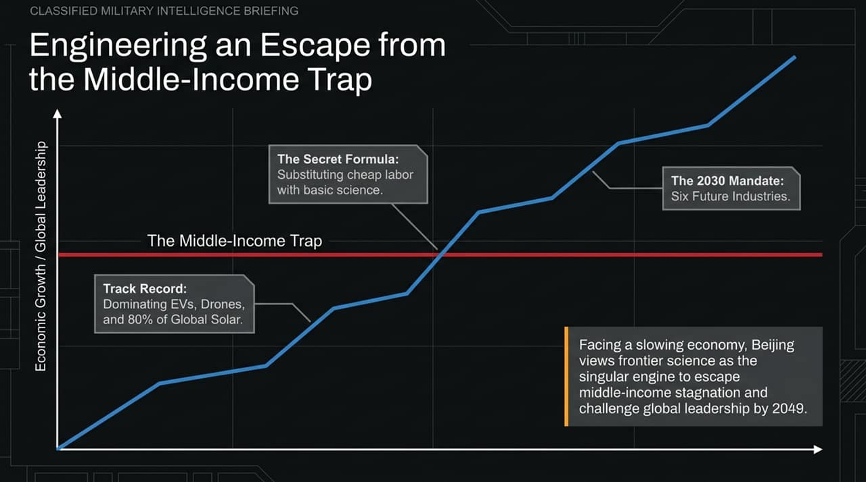
Notes:
The 2030 Mandate: This slide highlights the core priorities and execution mechanism behind Beijing's strategy.
Four Pillars of Dominance:
Embodied AI & Human-Robot Coexistence: China already accounted for 90% of global humanoid robot shipments in 2025. They are aggressively deploying embodied AI, 6G communication networks, and hyperscale data centers.
Brain-Computer Interfaces (BCI): Rapidly shifting from assisting disabled individuals to human capability enhancement, with commercial BCI devices reaching sub-100-millisecond latency.
Mega-Science Infrastructure: State-of-the-art facilities like the High Energy Photon Source (HEPS) are accelerating breakthroughs in biomanufacturing and pharmaceutical discovery.
Quantum & Fusion Breakthroughs: Advancing room-temperature quantum computing and Tokamak plasma stabilization for clean energy and compute dominance.
Governance Engine: What unites these efforts is the "whole-of-society" model, aligning universities, state banks, local governments, and capital markets to de-risk high-stakes, early-stage technologies.

Slide 3
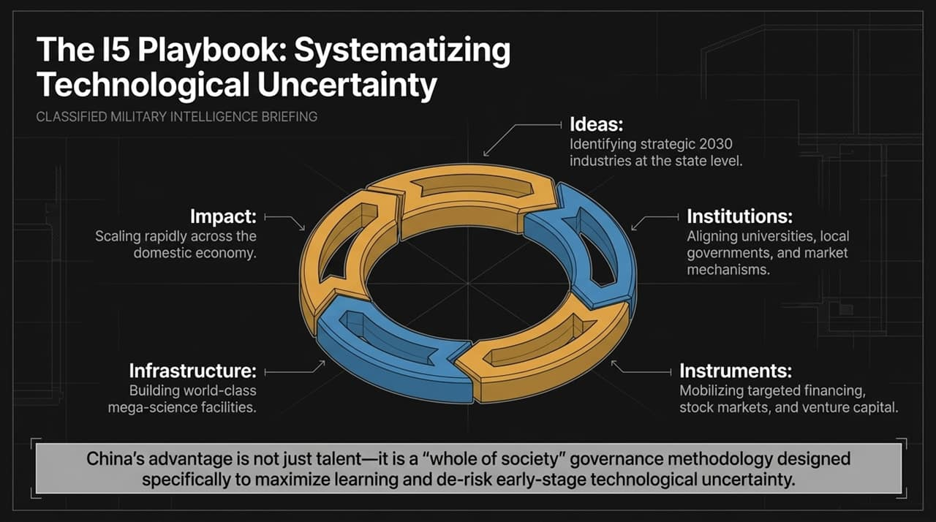
Notes:
Economic Transition: Why is Beijing pursuing basic frontier science so aggressively? Facing a slowing domestic economy and demographic aging, Beijing views basic science as the singular engine to escape the "Middle-Income Trap".
The Secret Formula: The structural shift is substituting cheap manufacturing labor with high-value basic science innovation.
Proven Track Record: This playbook is not theoretical. Over the last decade, China applied state-backed coordination to dominate:
Electric Vehicles (EVs): Surpassing traditional global automakers across major international markets.
Photovoltaics (Solar): Controlling over 80% of global solar panel production.
Low-Altitude Drones: Establishing undisputed global market leadership in cost and performance.
Strategic Goal: China is attempting to replicate its EV and solar success across the six priority future industries by 2030 to challenge global leadership by the PRC's 2049 centenary.

Slide 4
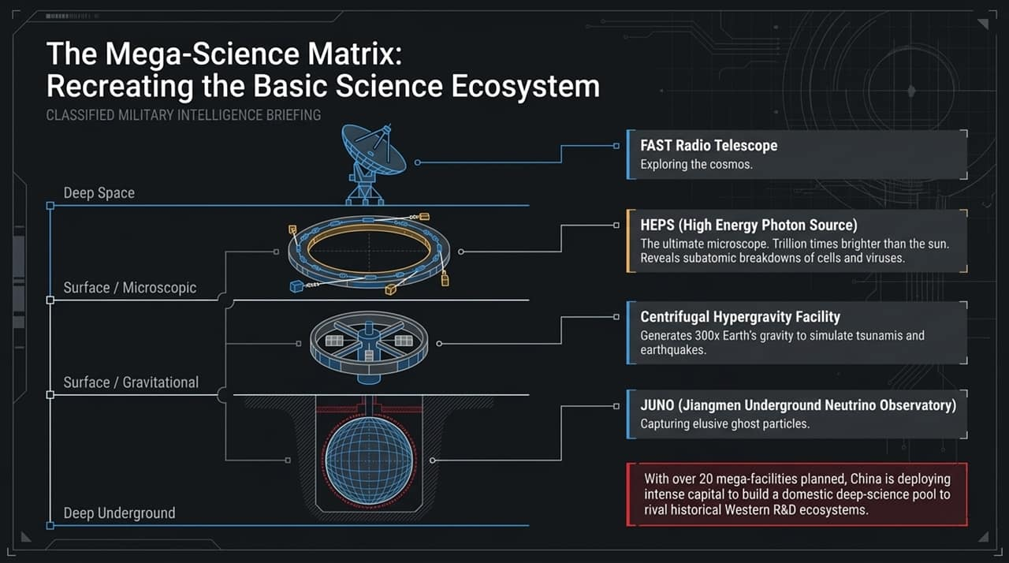
Notes:
De-risking Innovation: Many ask how China manages to commercialize high-risk technologies faster than Western market economies. The answer lies in their "I5" governance methodology:
Ideas: Strategic top-down selection of 2030 future industries by central planners.
Institutions: Alignment across universities, regional governments, and market mechanisms.
Instruments: Mobilizing policy banks, targeted venture capital, and dedicated stock market boards.
Infrastructure: Investing heavily in world-class mega-science facilities.
Impact: Rapidly scaling proven prototypes into the domestic economy.
Core Advantage: China’s edge is not just its sheer volume of STEM graduates; it is a systematic organizational methodology designed specifically to absorb financial risk and maximize learning under conditions of extreme technological uncertainty.

Slide 5
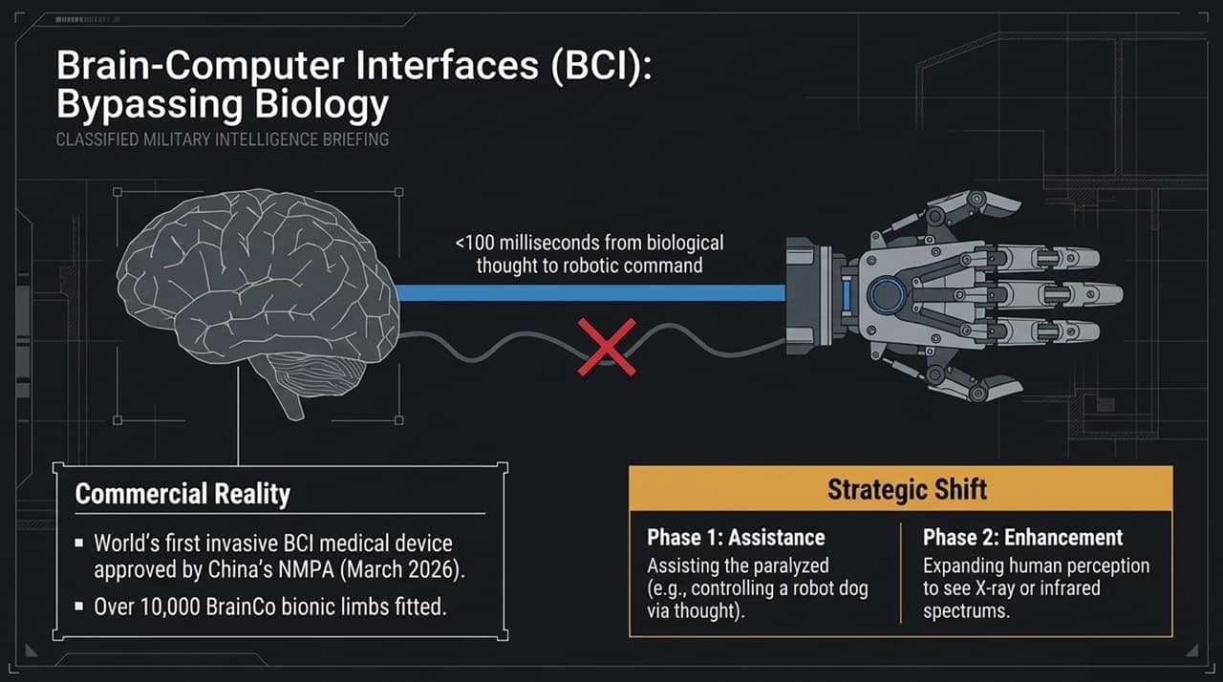
Notes:
Recreating Basic Science: Historically, breakthrough tech hubs like Silicon Valley were built on decades of foundational Western scientific R&D. China is attempting to build an equivalent domestic deep-science ecosystem overnight through its Mega-Science Matrix.
Key Facilities Spotlighted:
FAST Radio Telescope: Deep space exploration and cosmic observational research.
HEPS (High Energy Photon Source): An X-ray synchrotron light source a trillion times brighter than the sun, acting as the ultimate microscope to analyze viruses and advanced subatomic materials.
Centrifugal Hypergravity Facility: Generating forces over 300x Earth's gravity to simulate extreme events like tsunamis and earthquakes for infrastructure stress-testing.
JUNO (Jiangmen Underground Neutrino Observatory): Deep underground facility capturing elusive "ghost particles".
Strategic Intent: With over 20 additional mega-facilities planned, China is deploying capital intensity to reduce dependence on foreign scientific breakthroughs.

Slide 6
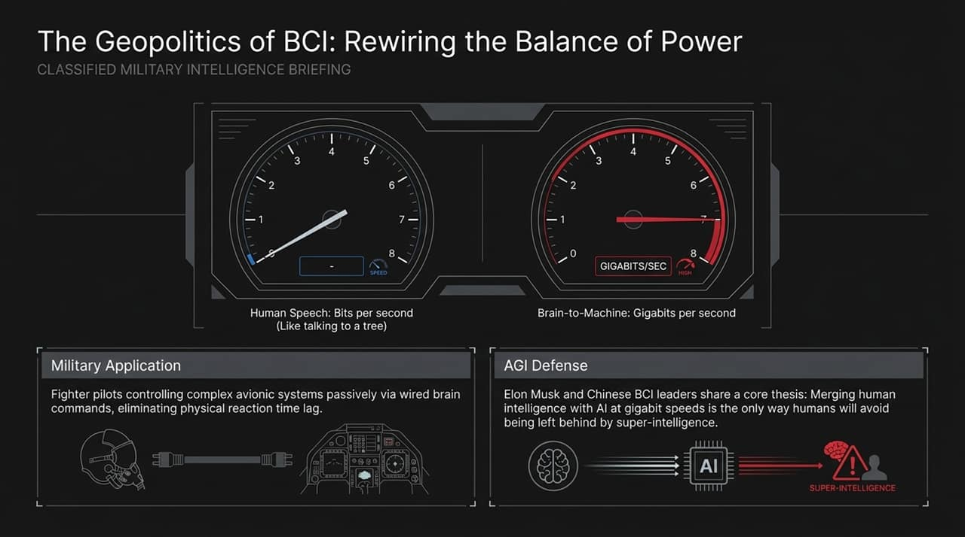
Notes:
State Priority: BCI is highlighted in China's 5-year plan as a key technological frontier.
Commercial Milestones:
Over 10,000 BrainCo bionic limbs have already been fitted, decoding brain signals into precise mechanical finger movements.
In March 2026, China's NMPA approved the world's first invasive BCI medical device for commercial release.
Clinical trials achieved sub-100-millisecond latency from biological thought to robotic execution (e.g., controlling robot dogs via thought implants).
Two-Phase Strategic Roadmap:
Phase 1 (Assistance): Medical rehabilitation for paralysis and neurological disorders.
Phase 2 (Enhancement): Augmenting healthy human sensory capabilities, allowing humans to perceive infrared or X-ray spectrums.

Slide 7
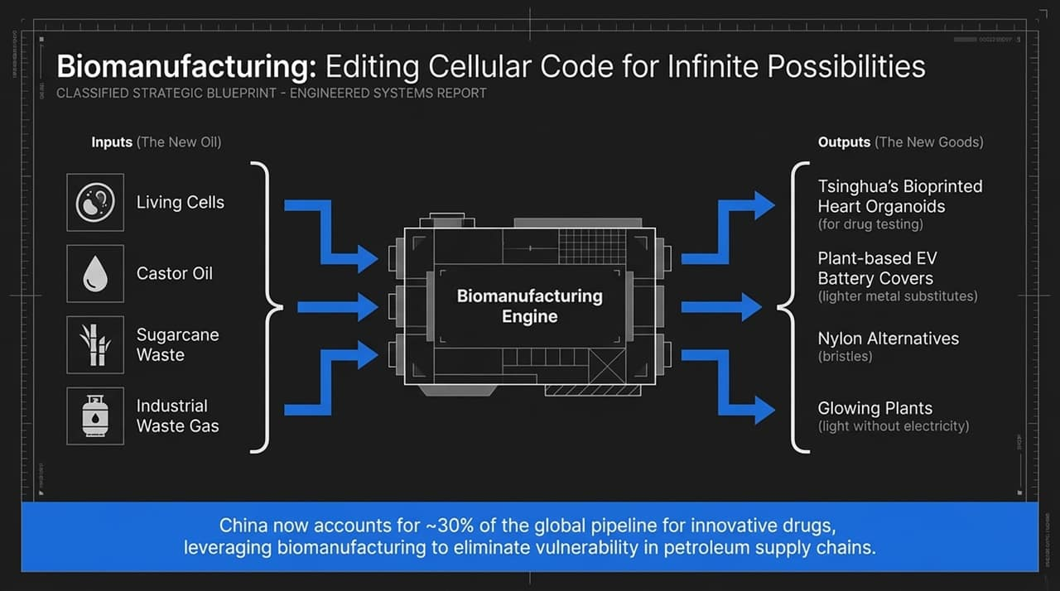
Notes:
The Bandwidth Bottleneck: Human speech operates at a slow rate of roughly bits per second—often described as "talking like a tree" compared to computer processing speeds. Direct BCI connections increase data transmission to gigabits per second.
Military Integration: Wired or direct BCI interfaces allow fighter pilots or drone swarm operators to control complex avionics passively via brain commands, completely eliminating physical reaction time lag.
AGI Defense Thesis: Shared by both Elon Musk's Neuralink and Chinese BCI directors: as AI scales toward super-intelligence, merging human cognition with machines at gigabit speeds is considered the primary defense to prevent human obsolescence.

Slide 8
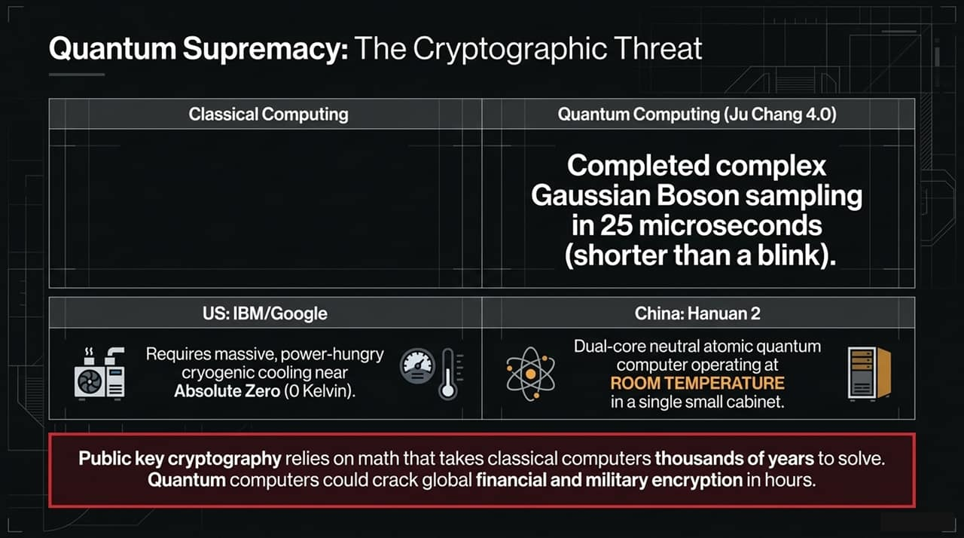
Notes:
Cellular Code as the New Oil: Biomanufacturing edits cellular biology to transform raw inputs into industrial goods.
Input-to-Output Engine:
Inputs: Living cells, castor oil, sugarcane waste, and captured industrial waste gas.
Outputs: 3D-bioprinted heart organoids (developed at Tsinghua University for drug testing), plant-based lightweight EV battery covers, petroleum-free nylon bristles, and dark-glowing plants.
Supply Chain Security: By producing critical chemical precursors and materials via bio-synthesis, China aims to decouple its supply chain from foreign petroleum imports and international trade disruption. China currently accounts for ~30% of the global innovative drug pipeline.

Slide 9
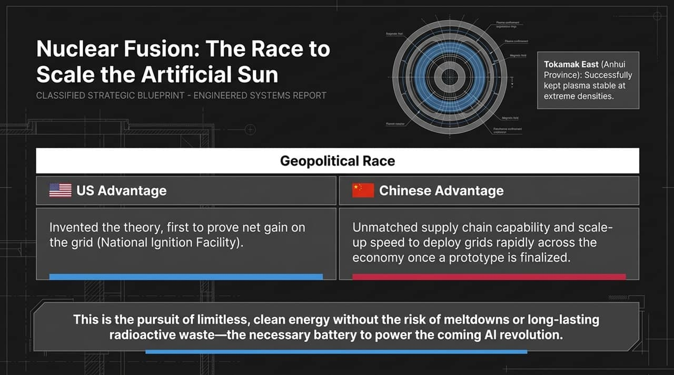
Notes:
The Cryptographic Risk: Modern global financial transactions and national security systems rely on public key cryptography. While classical supercomputers would take millennia to factor these algorithms, quantum systems can potentially breach them in hours.
Technological Breakdown:
US Paradigm (IBM/Google): Relies heavily on superconducting qubits requiring massive, power-hungry cryogenic cooling near Absolute Zero (0 Kelvin).
Chinese Breakthroughs:
Jiuzhang 4.0: Photonic quantum computing completing Gaussian Boson sampling in 25 microseconds.
Hanyuan 2: Dual-core neutral atomic quantum system operating at room temperature inside a single, compact cabinet.
Geopolitical Implication: Room-temperature quantum computing unlocks portable, scalable deployment without needing specialized cryogenic infrastructure.

Slide 10
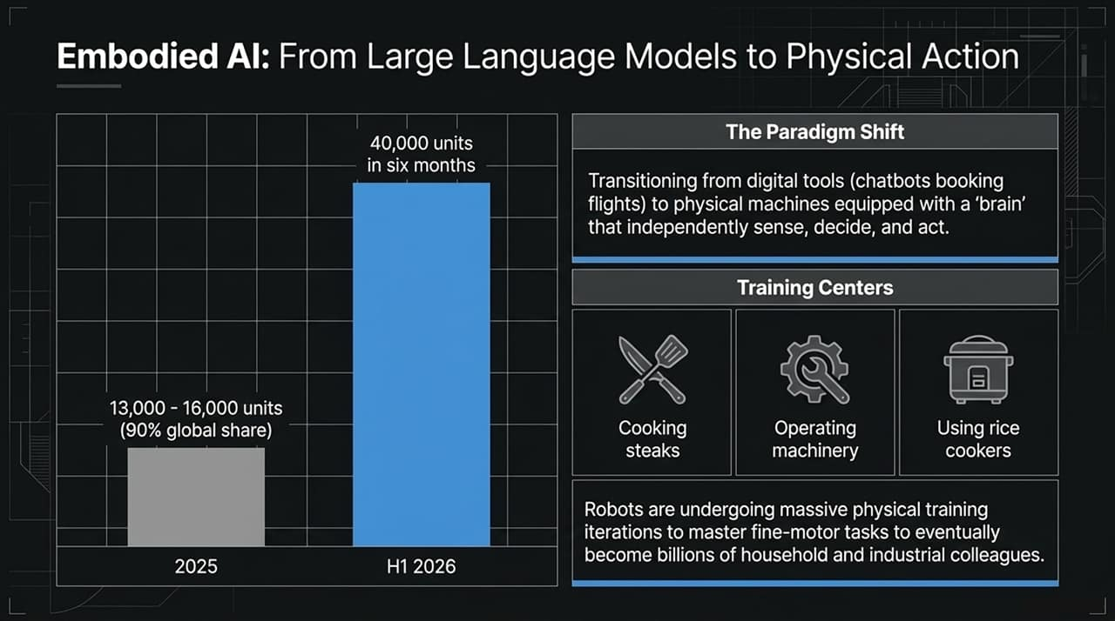
Notes:
The Ultimate Energy Source: Fusion offers zero-carbon, meltdown-free power without long-lived radioactive waste. Crucially, fusion serves as the base-load power supply required for energy-intensive AI compute clusters.
US vs. China Competition:
US Advantage: Historical theoretical leadership and proving net-energy gain (at the National Ignition Facility).
China Advantage (EAST Tokamak): World leader in maintaining ultra-high-density stable plasma containment over extended durations.
Deployment Race: Once a commercial prototype is finalized, China’s industrial supply chain scale and rapid construction capability will allow it to deploy fusion reactors across its national power grid significantly faster than Western counterparts.

Slide 11
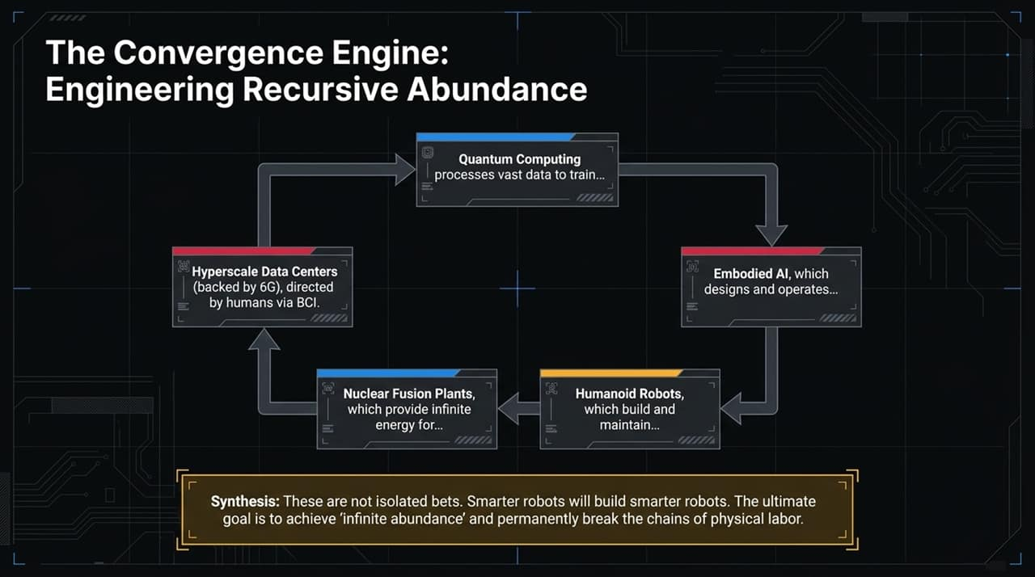
Notes:
The Paradigm Shift: Moving beyond text-based LLMs (like chatbots) to physical machines equipped with real-world sensory brains that independently sense, decide, and act.
Exponential Growth:
2025: China captured 90% of global humanoid robot shipments (13,000–16,000 units).
H1 2026: Shipments surged to 40,000 units in just six months.
Mass Physical Training Centers: Humanoid platforms are undergoing millions of physical iteration cycles—learning fine-motor tasks ranging from operating industrial machinery to preparing food and utilizing everyday household appliances.

Slide 12
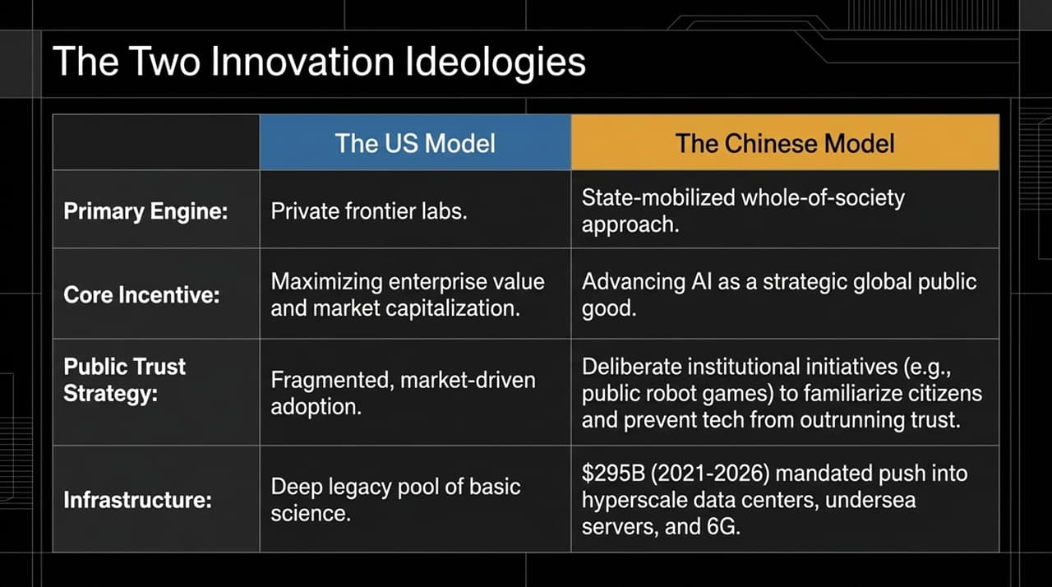
Notes:
Closed-Loop Ecosystem: China’s 2030 technology bets are not isolated industries; they form a self-reinforcing, closed-loop engine:
Nuclear Fusion provides limitless clean power to Hyperscale Data Centers & 6G.
BCI Systems allow humans to direct computing networks at gigabit speeds.
Quantum Computing accelerates machine learning models for Embodied AI.
Humanoid Robots maintain data centers, mine materials, and build next-generation hardware.
Recursive Innovation & Abundance: Smarter robots build even smarter robots. The ultimate economic goal is achieving "infinite abundance"—permanently decoupling economic output from human physical labor constraint.

Slide 13
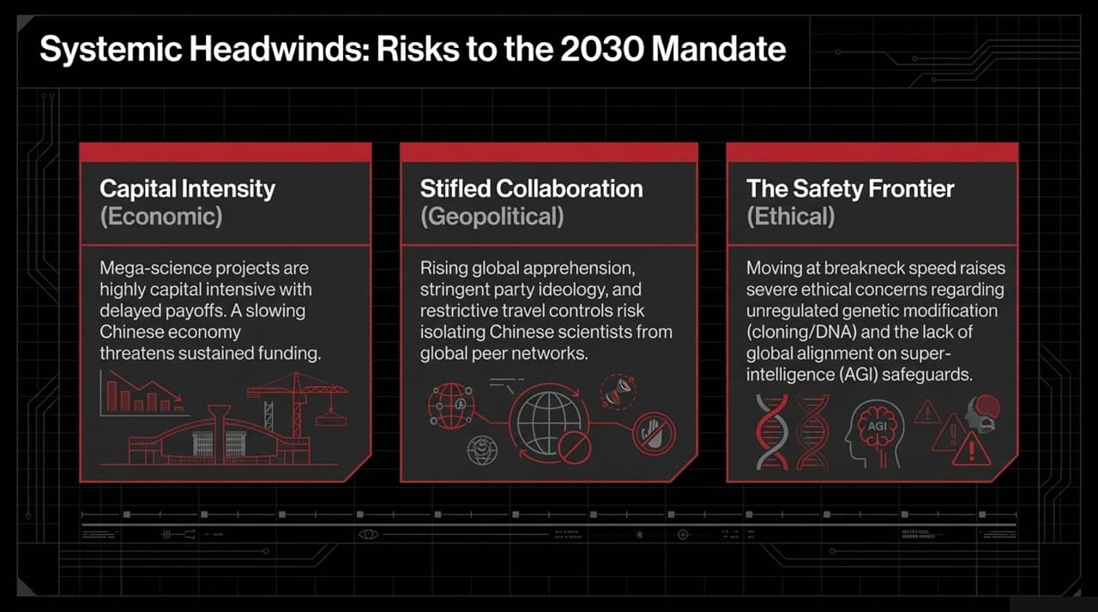
Notes:
Comparing Models: This slide contrasts the structural differences between the US and Chinese technology development models:
Primary Engine: US relies on private corporate venture labs; China leverages a state-mobilized "whole-of-society" apparatus.
Core Incentive: US focuses on shareholder equity and enterprise valuation; China views frontier AI and science as strategic public infrastructure.
Public Trust Strategy: US sees fragmented, market-driven adoption; China actively conducts public robot games and exhibitions to familiarize citizens and prevent tech backlash.
Infrastructure Commitment: China mandated $295B (2021–2026) for hyperscale computing, undersea server arrays, and national 6G testbeds.

Slide 14
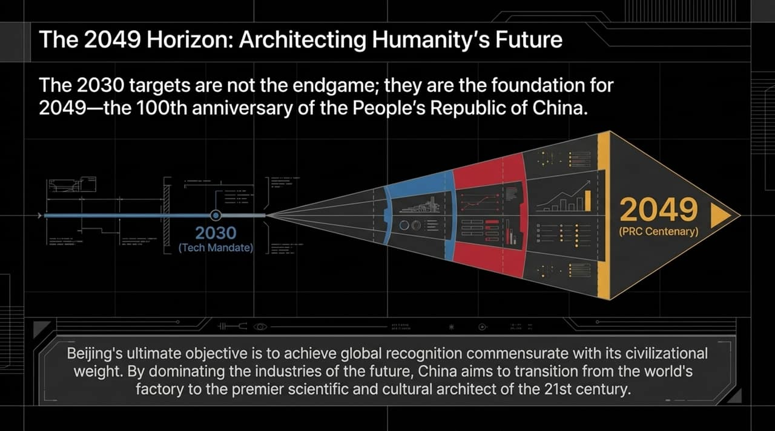
Notes:
Balanced Evaluation: Despite impressive momentum, China faces significant systemic headwinds that threaten its 2030 objectives:
Economic Capital Intensity: Mega-science research facilities require prolonged, high-intensity capital investment with uncertain payoff timelines—a major risk during a slowing domestic economy.
Geopolitical & Ideological Isolation: Stricter party alignment, geopolitical tensions, and restrictive international travel/collaboration controls risk isolating domestic researchers from global peer networks.
Ethical & Safety Boundaries: Rapid deployment without international ethical consensus raises severe risks regarding unregulated genetic engineering, cloning, and lack of alignment on AGI safeguards.

Slide 15
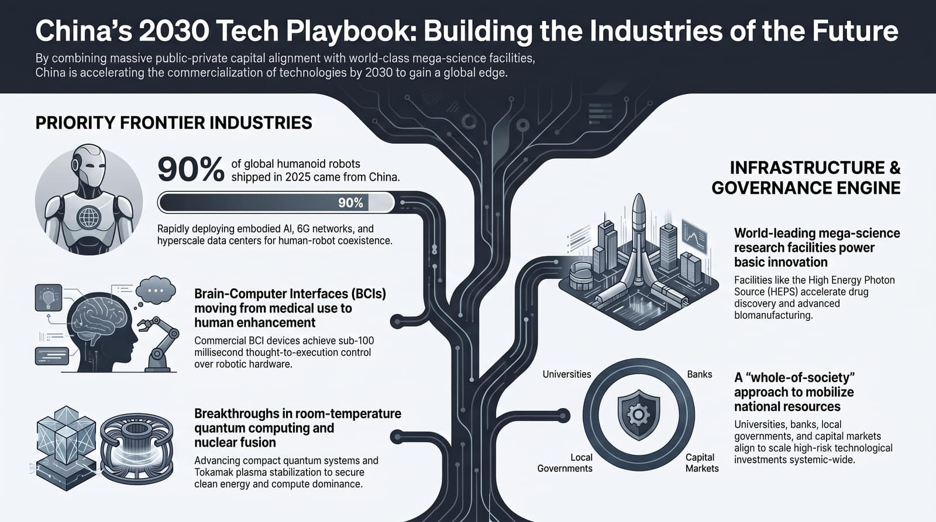
Notes:
The Long-Term Vision: The 2030 targets are intermediate checkpoints, not the ultimate destination. They lay the groundwork for 2049—the 100th anniversary of the founding of the People's Republic of China.
Civilizational Weight: Beijing's long-term objective is to establish global standing and authority commensurate with its historical civilizational weight.
Conclusion: By controlling the critical infrastructure, energy sources, and computing platforms of the future, China aims to fully transition from being "the world's factory" into becoming the world's primary scientific, economic, and technological architect of the 21st century.
Opening for Q&A: Thank you. I am now happy to take any questions.

